Slide 1
Demand Forecasting Methods
Master of Management Analytics
Session 1
G. Pond

Slide 2
Simple Linear Regression (SLR)

Slide 3
Linear Regression
Linear trend projection is essentially fitting our data into a straight line of the form we all learned in grade school:
$y=mx+b$ or $\hat{y}=b_{0}+b_{1}t$
There are formulas we can use to find the slope ($m$) and the vertical axis intercept ($b$). These formulas identify the values of $m$ and $b$ that minimize the mean squared error between the data and the linear model representing the data.
$$b_{1}=\frac{\sum{ty−\left(\sum{t}\sum{y}\right)/n}}{\sum{t^{2}−{\left(\sum{t}\right)}^{2}/n}}$$
$$b_{0}=\overline{y}−b_{1}\overline{t}$$

Slide 4
Linear Regression
…but realistically no one does that. It is tedious even on small data sets. There is an easier way. I can start by drawing out data as a scatter chart (or “scatter plot” or “scattergram”) in Excel.

Slide 5
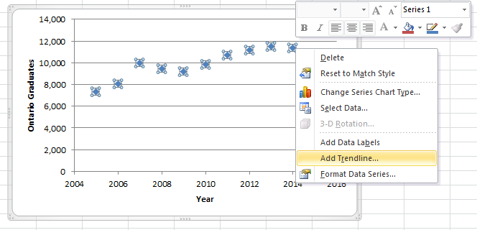
Linear Regression
Right-click on one of the points (in an Excel chart)
Select “Add Trendline”

Slide 6
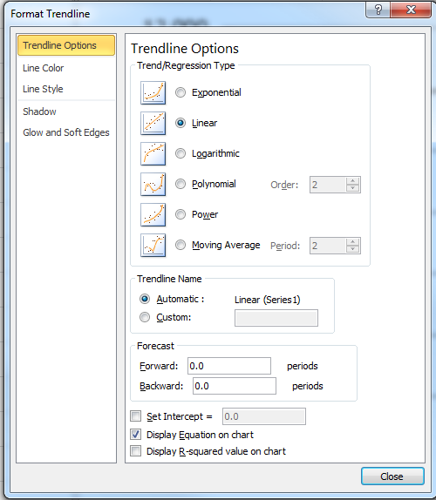
Linear Regression
In the window that opens, make the following selections:

Slide 7
Linear Regression
The equation we obtained mathematically was:
$$F_{t}=7,475+434t$$

Slide 8
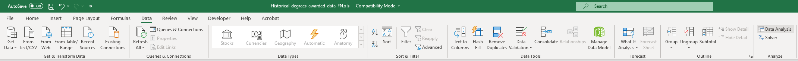
Linear Regression
There is another way that is just as easy (if not easier) and also provides additional information.
1
2

Slide 9
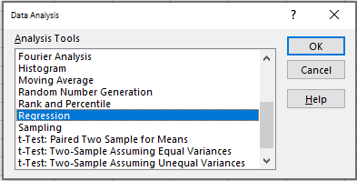
Linear Regression
Then select “Regression” in the new window that opens.
4
3

Slide 10
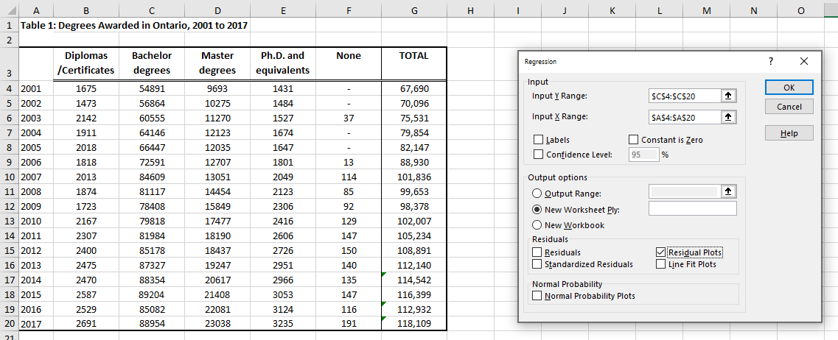
Linear Regression
Here I’m obtaining a regression of the number of degrees awarded as a function of the year. I also always like to plot the residuals…
5
8
6
7

Slide 11
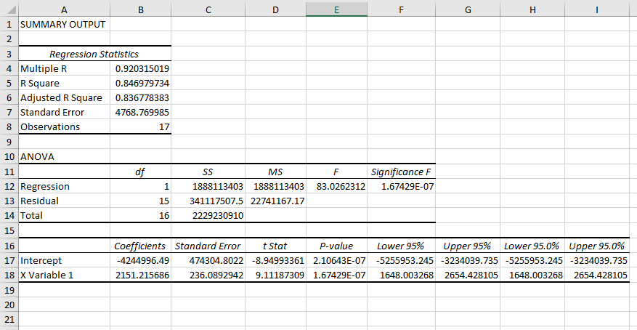
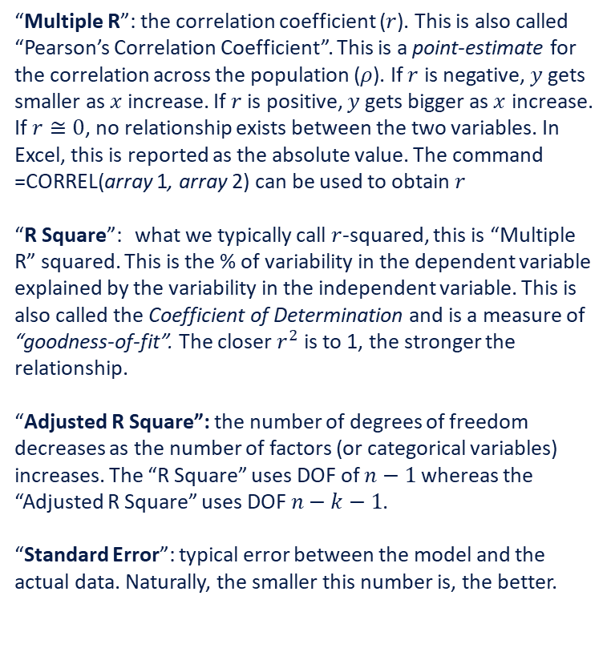
Linear Regression
“Multiple R”: the correlation coefficient ($r$). This is also called “Pearson’s Correlation Coefficient”. This is a point-estimate for the correlation across the population ($ρ$). If $r$ is negative, $y$ gets smaller as $x$ increase. If $r$ is positive, $y$ gets bigger as $x$ increase. If $r≅0$, no relationship exists between the two variables. In Excel, this is reported as the absolute value. The command =CORREL(array 1, array 2) can be used to obtain $r$
“R Square”: what we typically call $r$-squared, this is “Multiple R” squared. This is the % of variability in the dependent variable explained by the variability in the independent variable. This is also called the Coefficient of Determination and is a measure of “goodness-of-fit”. The closer $r^{2}$ is to 1, the stronger the relationship.
“Adjusted R Square”: the number of degrees of freedom decreases as the number of factors (or categorical variables) increases. The “R Square” uses DOF of $n−1$ whereas the “Adjusted R Square” uses DOF $n−k−1$.
“Standard Error”: typical error between the model and the actual data. Naturally, the smaller this number is, the better.
The default CI is 95% so this will always be provided
You can choose to also have Excel provide a different confidence level that would appear here

Slide 12
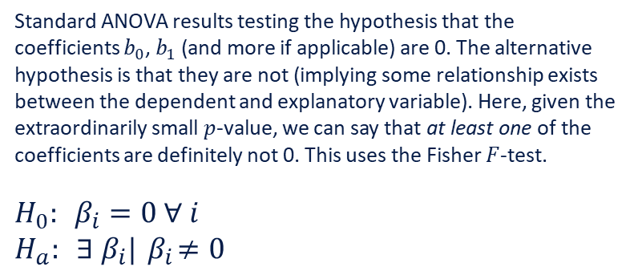
Linear Regression
And we will get a summary table as illustrated below….
Standard ANOVA results testing the hypothesis that the coefficients $b_{0}$, $b_{1}$ (and more if applicable) are 0. The alternative hypothesis is that they are not (implying some relationship exists between the dependent and explanatory variable). Here, given the extraordinarily small $p$-value, we can say that at least one of the coefficients are definitely not 0. This uses the Fisher $F$-test.
$H_{0}: β_{i}=0 ∀ i$
$H_{a}: ∃ β_{i}|{ β}_{i}≠0$

Slide 13
Linear Regression
And we will get a summary table as illustrated below….
Sometimes we will obtain rather unhelpful coefficients if using the equation on the scatter plot (like “1E8”). I can obtain reporting of more digits in the coefficient from here. I also get $p$-values by coefficient (unlike in the ANOVA table). When doing multiple linear regression, this tells me which among the explanatory variables is useful and which are not. It also gives me a 95% confidence interval (by default) on the coefficient’s values.

Slide 14
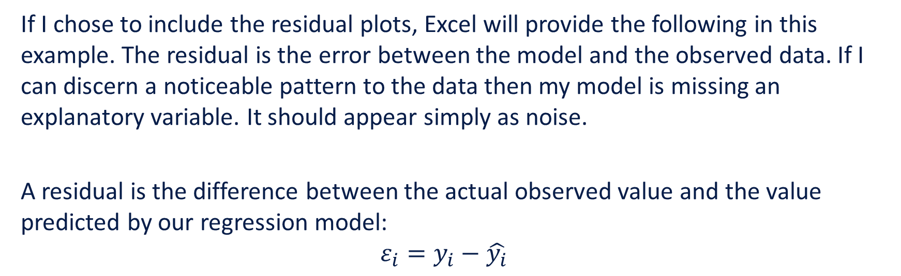
Linear Regression
If I chose to include the residual plots, Excel will provide the following in this example. The residual is the error between the model and the observed data. If I can discern a noticeable pattern to the data then my model is missing an explanatory variable. It should appear simply as noise.
A residual is the difference between the actual observed value and the value predicted by our regression model:
$$ε_{i}=y_{i}−\hat{y_{i}}$$

Slide 15
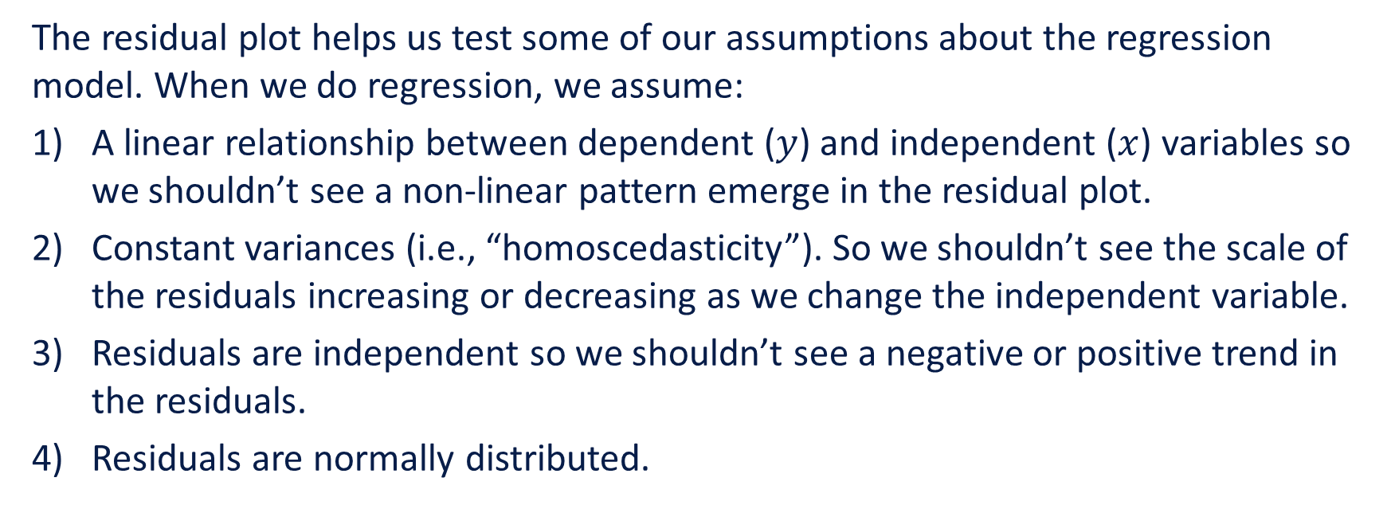
Linear Regression
The residual plot helps us test some of our assumptions about the regression model. When we do regression, we assume:
A linear relationship between dependent ($y$) and independent ($x$) variables so we shouldn’t see a non-linear pattern emerge in the residual plot.
Constant variances (i.e., “homoscedasticity”). So we shouldn’t see the scale of the residuals increasing or decreasing as we change the independent variable.
Residuals are independent so we shouldn’t see a negative or positive trend in the residuals.
Residuals are normally distributed.

Slide 16
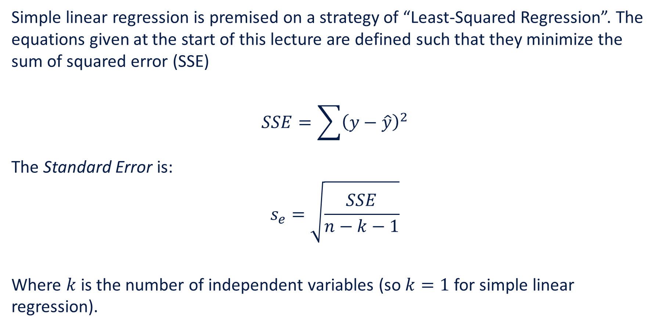
Linear Regression
Simple linear regression is premised on a strategy of “Least-Squared Regression”. The equations given at the start of this lecture are defined such that they minimize the sum of squared error (SSE)
$$SSE=\sum{{\left(y−\hat{y}\right)}^{2}}$$
The Standard Error is:
$$s_{e}=\sqrt{\frac{SSE}{n−k−1}}$$
Where $k$ is the number of independent variables (so $k=1$ for simple linear regression).

Slide 17
Multiple Linear Regression (MLR)

Slide 18
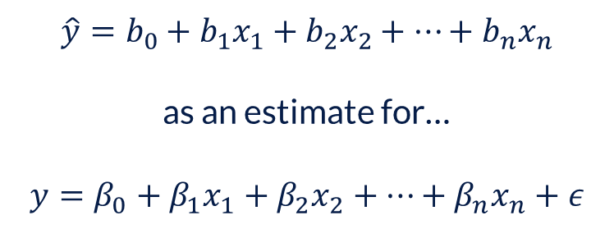
Multiple Linear Regression
Used when predicting one “output” or “response” variable is a function of a multiple continuous “input” or predictor variables. The response variable must be continuous.
Example: predicting vehicle cost as a function of its safety rating, fuel economy, and reliability
$$\hat{y}=b_{0}+b_{1}x_{1}+b_{2}x_{2}+…+b_{n}x_{n}$$
as an estimate for…
$$y=β_{0}+β_{1}x_{1}+β_{2}x_{2}+…+β_{n}x_{n}+ε$$

Slide 19
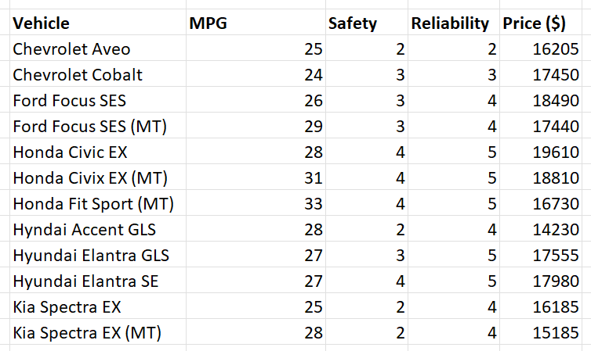

Multiple Linear Regression
Suppose I have the data depicted below and I’d like to be able to establish the price as a function of the vehicle’s fuel economy (MPG), safety rating, and reliability rating…
$$\hat{y}=b_{0}+b_{1}x_{1}+b_{2}x_{2}+b_{3}x_{3}$$
$$\text{Price}=b_{0}+b_{1}\text{(}\text{MPG}\text{)}+b_{2}\text{(}\text{Safety} \text{Rating}\text{)}+b_{3}\text{(}\text{Reliability} \text{Rating}\text{)}$$
Note: It will be easier for you if, in Excel, you have all your predictor variables in adjacent columns.

Slide 20
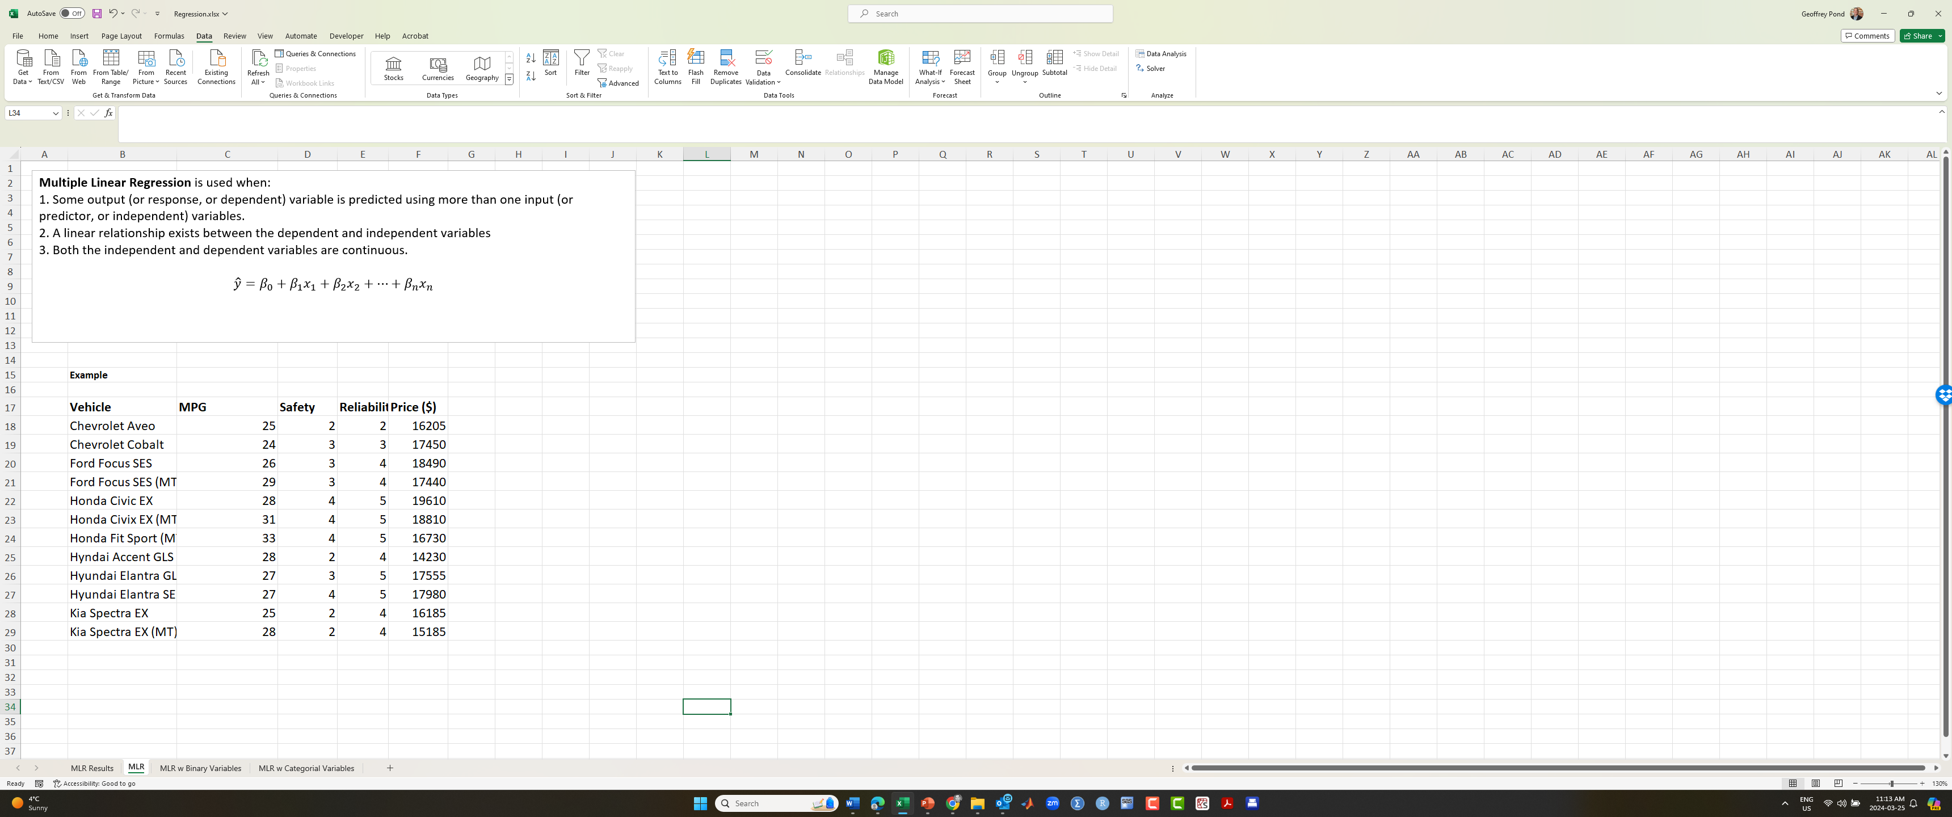
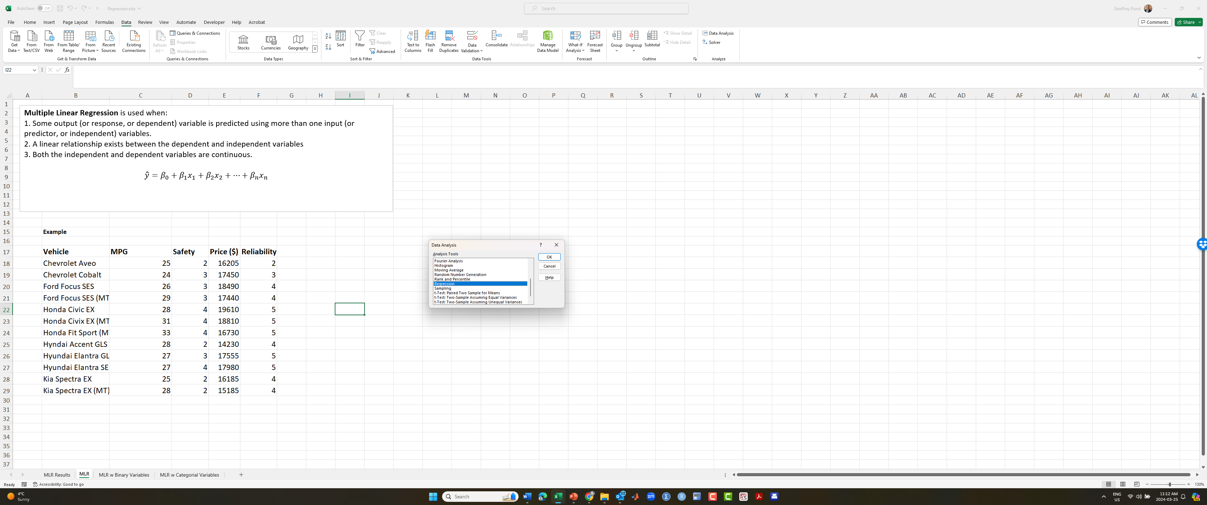
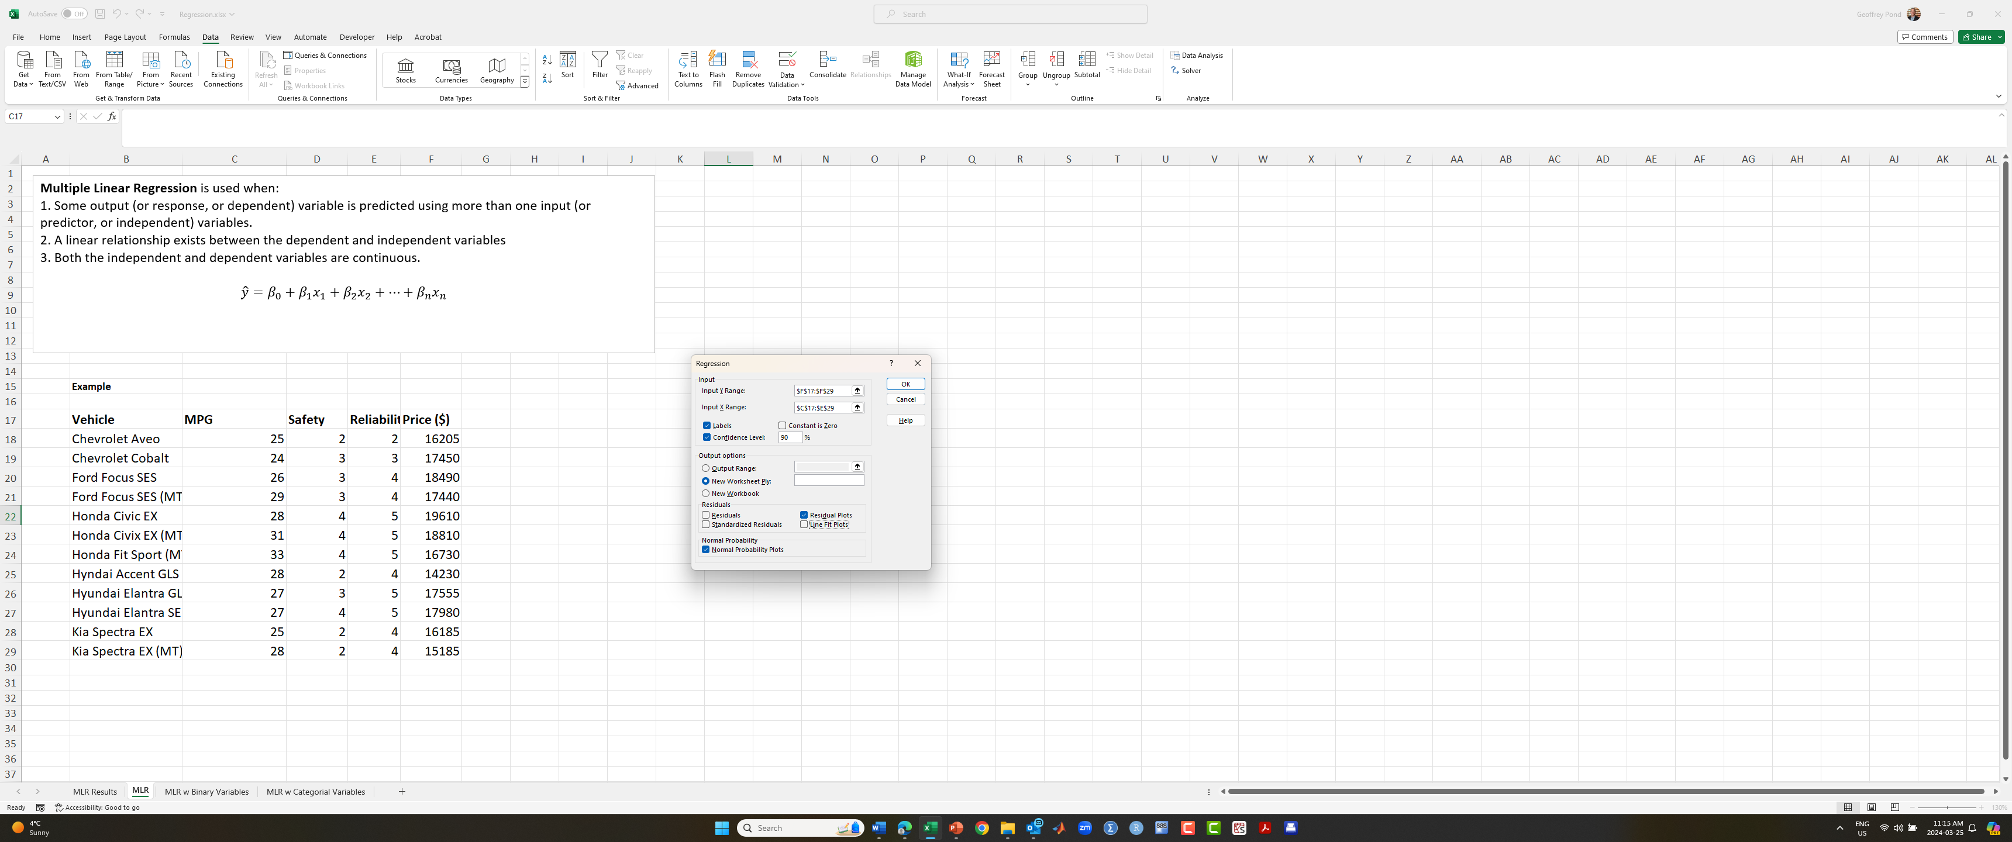
Multiple Linear Regression

Slide 21
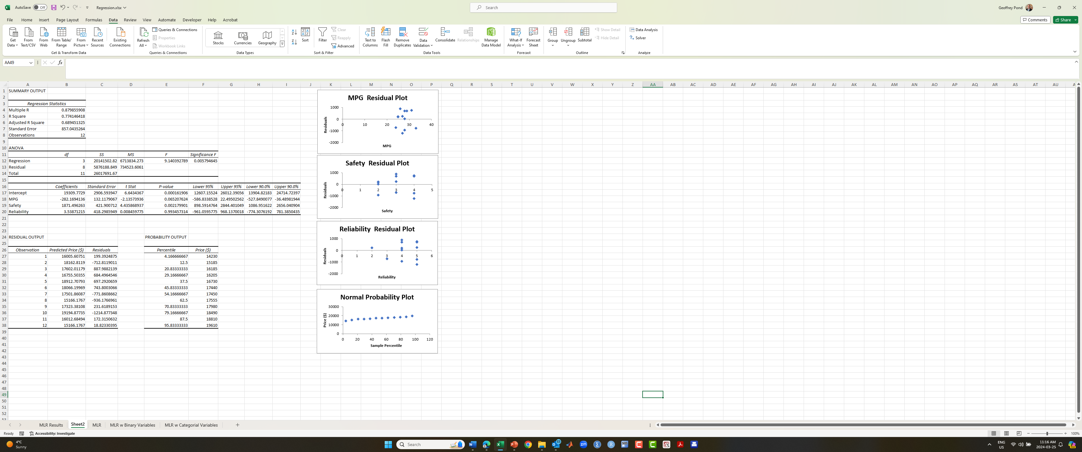
Multiple Linear Regression
Note: As we’re now doing multiple linear regression, it’s quite useful to ensure labels are included in your data selection. Doing so implies they will be called by that label in this report, so you don’t have to guess which coefficient is associated with which variable.

Slide 22
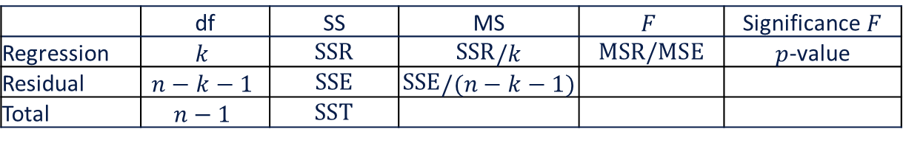
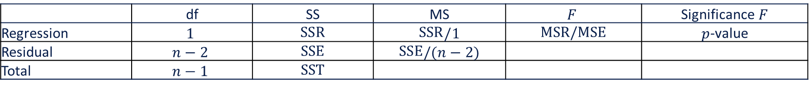

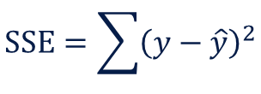
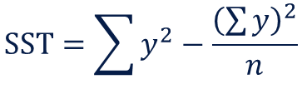
Multiple Linear Regression
The contents of the ANOVA table for Simple Linear Regression (SLR) is as follows:
 | df | SS | MS | $$F$$ | Significance $F$
Regression | $$1$$ | $$\text{SSR}$$ | $$\text{SSR}/1$$ | $$\text{MSR}\text{/}\text{MSE}$$ | $p$-value
Residual | $$n−2$$ | $$\text{SSE}$$ | $$\text{SSE}/(n−2)$$
Total | $$n−1$$ | $$\text{SST}$$
The contents of the ANOVA table for Multiple Linear Regression (MLR) is as follows:
 | df | SS | MS | $$F$$ | Significance $F$
Regression | $$k$$ | $$\text{SSR}$$ | $$\text{SSR}/k$$ | $$\text{MSR}\text{/}\text{MSE}$$ | $p$-value
Residual | $$n−k−1$$ | $$\text{SSE}$$ | $$\text{SSE}/(n−k−1)$$
Total | $$n−1$$ | $$\text{SST}$$
$$SST=\sum{y^{2}−\frac{{\left(\sum{y}\right)}^{2}}{n}}$$
$$SSE=\sum{{\left(y−\hat{y}\right)}^{2}}$$
$$SSR=\text{SST}−\text{SSE}$$

Slide 23
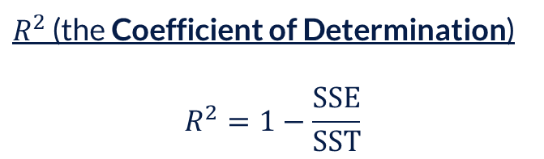
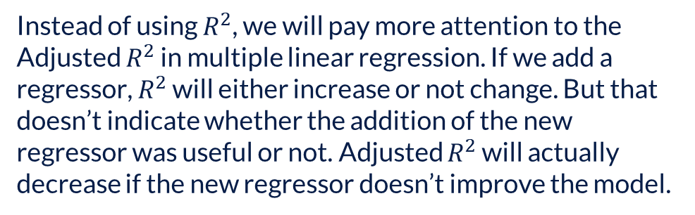
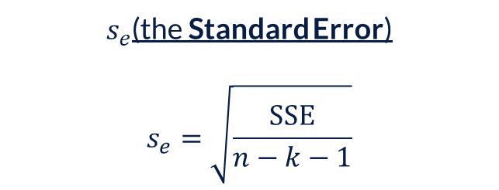
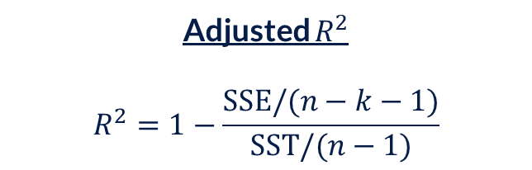
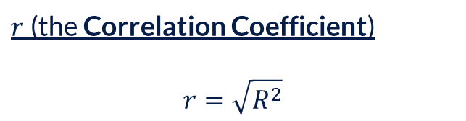
Multiple Linear Regression
$r$(the Correlation Coefficient)
$$r=\sqrt{R^{2}}$$
$R^{2}$ (the Coefficient of Determination)
$$R^{2}=1−\frac{\text{SSE}}{\text{SST}}$$
Adjusted $R^{2}$
$$R^{2}=1−\frac{\text{SSE}/(n−k−1)}{\text{SST}/(n−1)}$$
Instead of using $R^{2}$, we will pay more attention to the Adjusted $R^{2}$ in multiple linear regression. If we add a regressor, $R^{2}$ will either increase or not change. But that doesn’t indicate whether the addition of the new regressor was useful or not. Adjusted $R^{2}$ will actually decrease if the new regressor doesn’t improve the model.
$s_{e}$(the Standard Error)
$$s_{e}=\sqrt{\frac{\text{SSE}}{n−k−1}}$$

Slide 24

Multiple Linear Regression – Dummy Variables
Used when one of our input (or predictor) variables is categorical.
Example: predicting vehicle disease risk as a function of continuous variables (e.g., age, blood pressure) and a binary categorical variable (e.g., whether the patient is a smoker or not)
We can still do this in Excel also but we may need to put in a bit more effort in formatting the data (e.g., using the “if” worksheet function to change qualitative statements into numerical binary variables [0,1])..
$$\hat{y}=β_{0}+β_{1}x_{1}+β_{2}x_{2}+…+β_{n}x_{n}$$
We would then run the usual procedure in Microsoft Excel but using ONLY the code [0,1] variable to represent “Smoker”

Slide 25
Multiple Linear Regression – Dummy Variables
We can also use dummy variables to represent a categorical predictor variable….
Revenue | Date | Day
$5,847.97 | 15-Jul | Wednesday
$6,528.56 | 16-Jul | Thursday
$7,572.96 | 17-Jul | Friday
$6,864.70 | 18-Jul | Saturday
$7,178.96 | 22-Jul | Wednesday
$7,682.11 | 23-Jul | Thursday
$8,284.11 | 24-Jul | Friday
$7,910.90 | 25-Jul | Saturday
Revenue | Date | Day | Day | Wed | Thur | Fri | Sat
$5,847.97 | 15-Jul | 1 | Wednesday | 1 | 0 | 0 | 0
$6,528.56 | 16-Jul | 2 | Thursday | 0 | 1 | 0 | 0
$7,572.96 | 17-Jul | 3 | Friday | 0 | 0 | 1 | 0
$6,864.70 | 18-Jul | 4 | Saturday | 0 | 0 | 0 | 0
$7,178.96 | 22-Jul | 5 | Wednesday | 1 | 0 | 0 | 0
$7,682.11 | 23-Jul | 6 | Thursday | 0 | 1 | 0 | 0
$8,284.11 | 24-Jul | 7 | Friday | 0 | 0 | 1 | 0
$7,910.90 | 25-Jul | 8 | Saturday | 0 | 0 | 0 | 0
Excel won’t like the date format so I’ve recoded it as illustrated
Excel won’t like the words used to represent the day of the week so I’ve created four dummy variables that take on values of either [1,0] for each day. DO NOT code them as 1,2,3,4 for the four days (that would be used for an ordinal variable).

Slide 26
Multiple Linear Regression – Model Building
How do we know what variables to include in our model? There are different strategies that might be used to build the model.
Strategy #1: Stepwise Regression
Step 1: Do Simple Linear Regression with each of your candidate regressors (one at a time).
Step 2: Start building your model using the regressor that obtained the largest F-statistic in the first step (assuming it was found to be significant).
Step 3: Now, iteratively add each of the other candidate regressors to the existing model developed in Step 2 (but only one at a time). Add only the regressor that yielded the largest t-statistic. If none were significant, the model obtained in Step 2 is complete. If, by adding a second regressor, the first becomes insignificant, eliminate the earlier regressor.
Step 4: Continue in this manner until all regressors having significant t-statistics are included.

Slide 27
Multiple Linear Regression – Model Building
How do we know what variables to include in our model? There are different strategies that might be used to build the model.
Strategy #2: Forward Selection
Step 1: Do Simple Linear Regression with each of your candidate regressors (one at a time).
Step 2: Start building your model using the regressor that obtained the largest t-statistic in the first step (assuming it was found to be significant).
Step 3: Now, iteratively add each of the other candidate regressors to the existing model developed in Step 2 (but only one at a time). Add only the regressor that yielded the largest t-statistic. If none were significant, the model obtained in Step 2 is complete.
Step 4: Continue in this manner until all regressors having significant t-statistics are included.

Slide 28
Multiple Linear Regression – Model Building
How do we know what variables to include in our model? There are different strategies that might be used to build the model.
Strategy #2: Backward Elimination
Step 1: Start by executing Multiple Linear Regression with all of your regressors.
Step 2: Eliminate the regressor having the smallest non-significant t-statistic.
Step 3: Repeat until only significant regressors remain in your model.

Slide 29
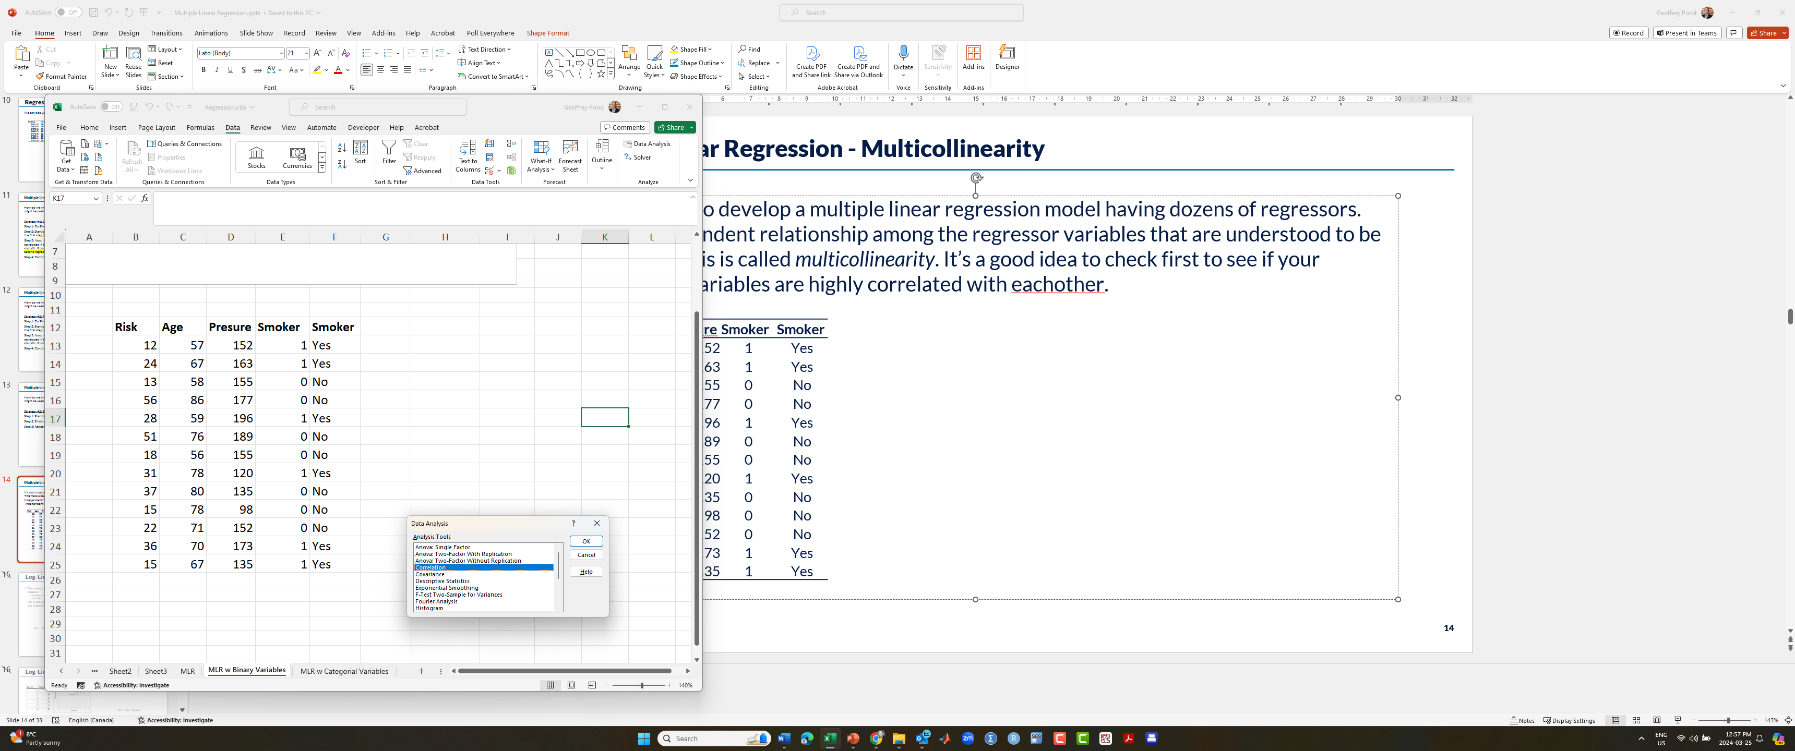
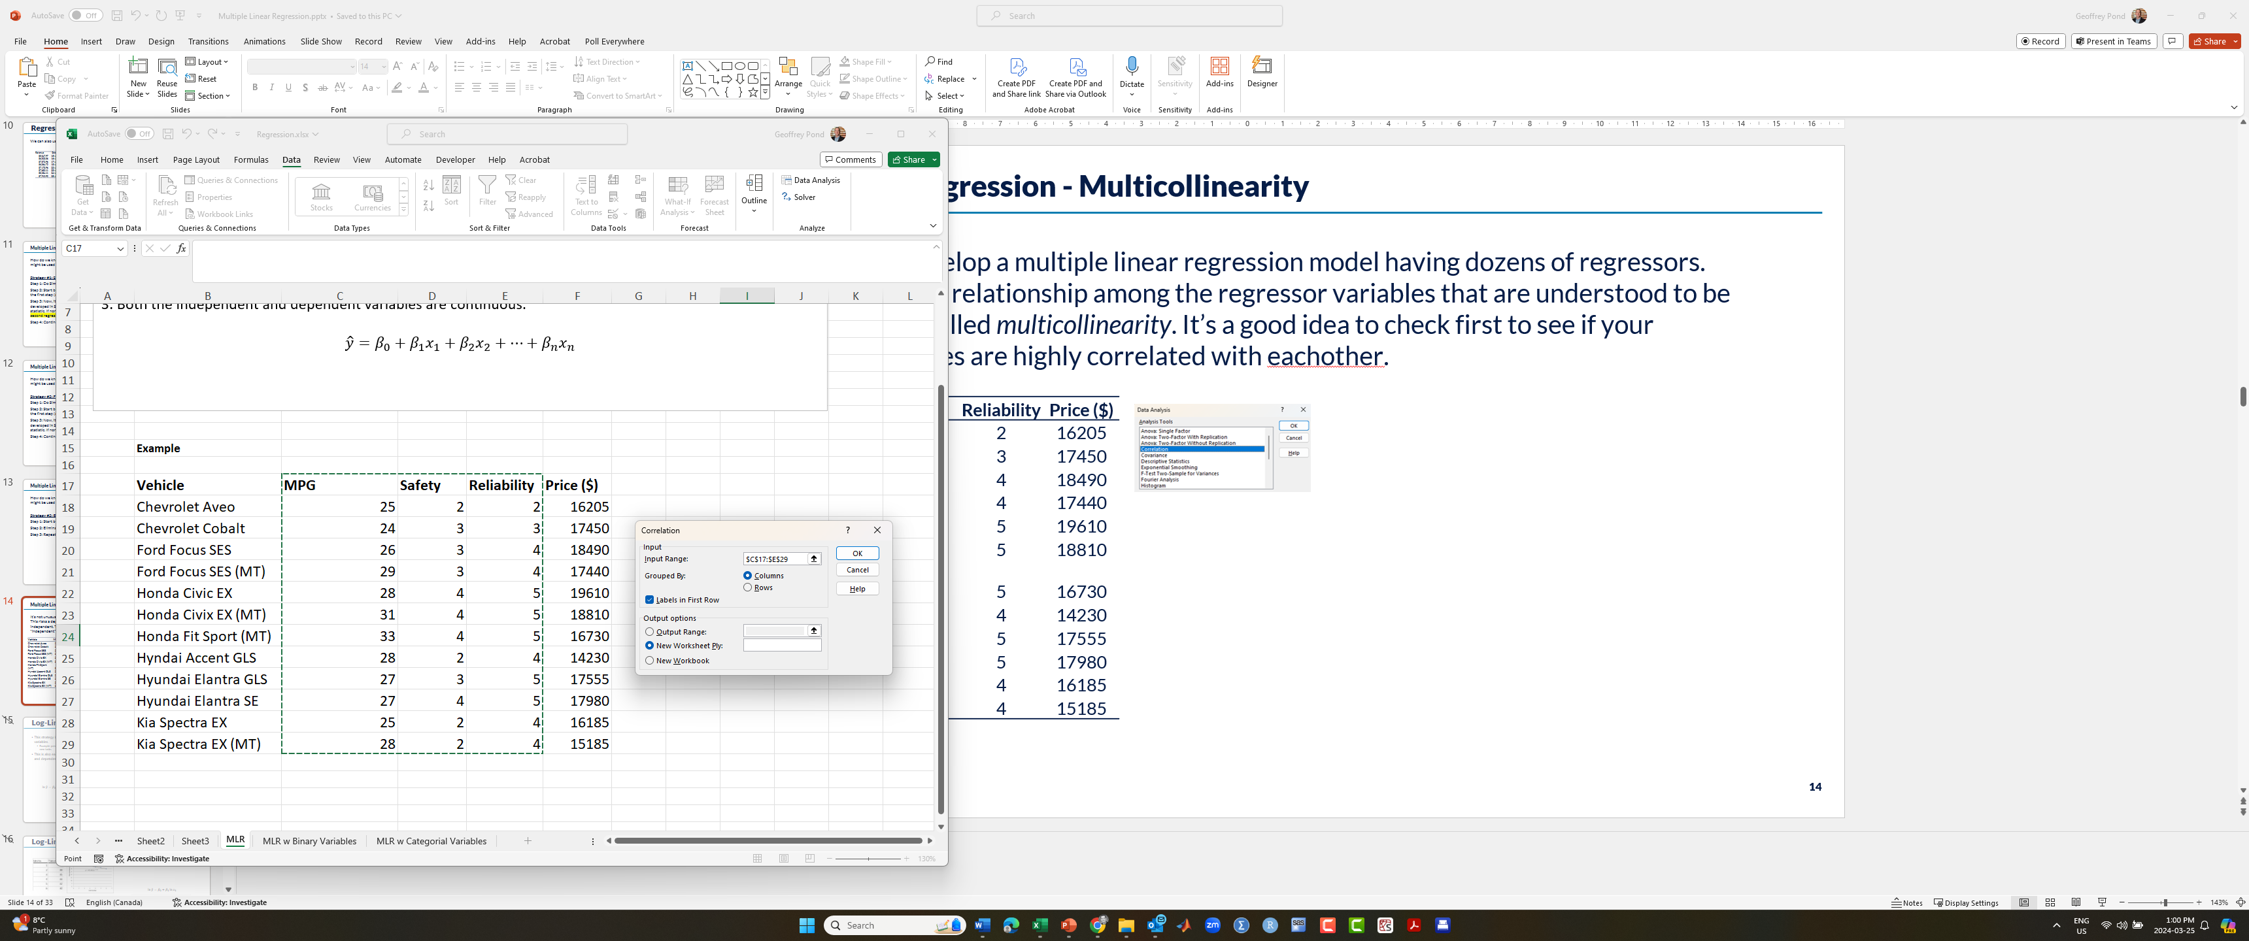
Multiple Linear Regression – Multicollinearity
It’s not unusual to develop a multiple linear regression model having dozens of regressors. This risks a dependent relationship among the regressor variables that are understood to be independent. This is called multicollinearity. It’s a good idea to check first to see if your “independent” variables are highly correlated with eachother.
Vehicle | MPG | Safety | Reliability | Price ($)
Chevrolet Aveo | 25 | 2 | 2 | 16205
Chevrolet Cobalt | 24 | 3 | 3 | 17450
Ford Focus SES | 26 | 3 | 4 | 18490
Ford Focus SES (MT) | 29 | 3 | 4 | 17440
Honda Civic EX | 28 | 4 | 5 | 19610
Honda Civix EX (MT) | 31 | 4 | 5 | 18810
Honda Fit Sport (MT) | 33 | 4 | 5 | 16730
Hyndai Accent GLS | 28 | 2 | 4 | 14230
Hyundai Elantra GLS | 27 | 3 | 5 | 17555
Hyundai Elantra SE | 27 | 4 | 5 | 17980
Kia Spectra EX | 25 | 2 | 4 | 16185
Kia Spectra EX (MT) | 28 | 2 | 4 | 15185
 | MPG | Safety | Reliability
MPG | 1
Safety | 0.538251136 | 1
Reliability | 0.634042469 | 0.682288239 | 1

Slide 30
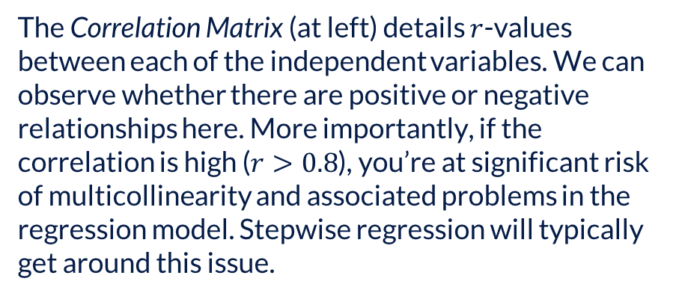
Multiple Linear Regression – Multicollinearity
It’s not unusual to develop a multiple linear regression model having dozens of regressors. This risks a dependent relationship among the regressor variables that are understood to be independent. This is called multicollinearity. It’s a good idea to check first to see if your “independent” variables are highly correlated with eachother.
The Correlation Matrix (at left) details $r$-values between each of the independent variables. We can observe whether there are positive or negative relationships here. More importantly, if the correlation is high ($r>0.8$), you’re at significant risk of multicollinearity and associated problems in the regression model. Stepwise regression will typically get around this issue.
 | MPG | Safety | Reliability
MPG | 1
Safety | 0.538251136 | 1
Reliability | 0.634042469 | 0.682288239 | 1

Slide 31
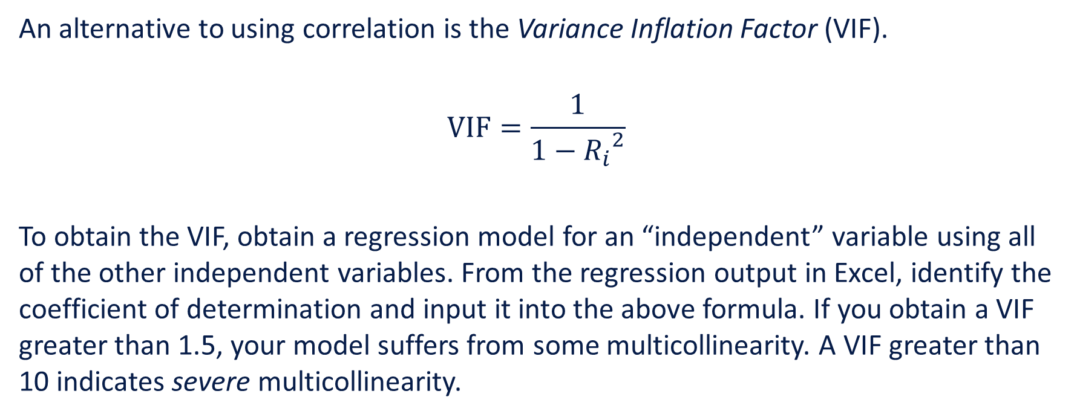
Multiple Linear Regression – VIF
An alternative to using correlation is the Variance Inflation Factor (VIF).
$$\text{VIF}=\frac{1}{1−{R_{i}}^{2}}$$
To obtain the VIF, obtain a regression model for an “independent” variable using all of the other independent variables. From the regression output in Excel, identify the coefficient of determination and input it into the above formula. If you obtain a VIF greater than 1.5, your model suffers from some multicollinearity. A VIF greater than 10 indicates severe multicollinearity.

Slide 32
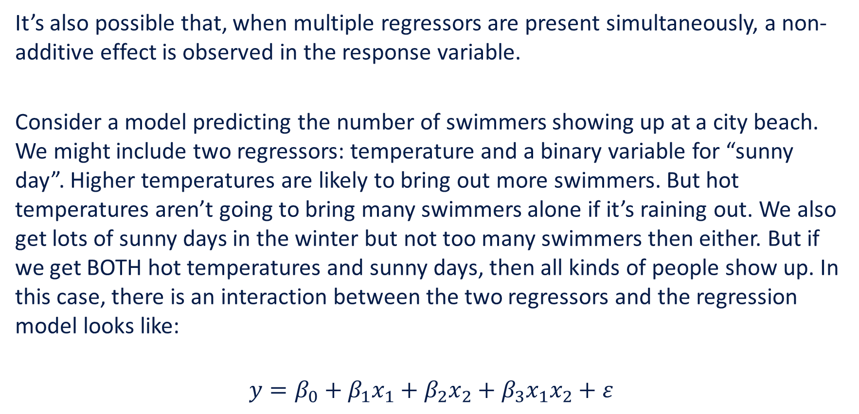
Multiple Linear Regression – Interaction
It’s also possible that, when multiple regressors are present simultaneously, a non-additive effect is observed in the response variable.
Consider a model predicting the number of swimmers showing up at a city beach. We might include two regressors: temperature and a binary variable for “sunny day”. Higher temperatures are likely to bring out more swimmers. But hot temperatures aren’t going to bring many swimmers alone if it’s raining out. We also get lots of sunny days in the winter but not too many swimmers then either. But if we get BOTH hot temperatures and sunny days, then all kinds of people show up. In this case, there is an interaction between the two regressors and the regression model looks like:
$$y=β_{0}+β_{1}x_{1}+β_{2}x_{2}+β_{3}x_{1}x_{2}+ε$$

Slide 33
Log-Linear Regression

Slide 34
Log-Linear Regression
This strategy is used when a non-linear relationship exists between the independent and dependent variables.
Example: predicting productivity as a function of “learning”. The rate of increase tends to decline exponentially as workers learn new tasks.
This is also easy to do in Excel. All we need to do is take the natural logarithm of the independent and/or dependent variables.
$$\ln{\hat{y}}=β_{0}+β_{1}\ln{x_{1}}+β_{2}\ln{x_{2}}+…+β_{n}\ln{x_{n}}$$

Slide 35
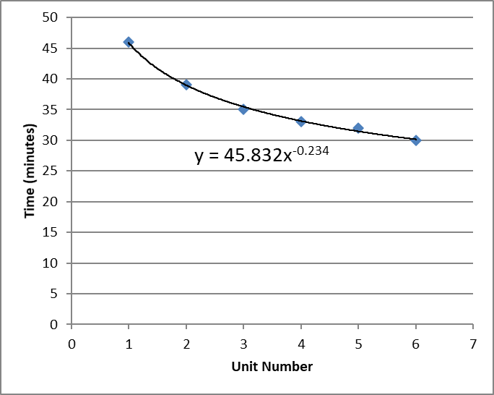
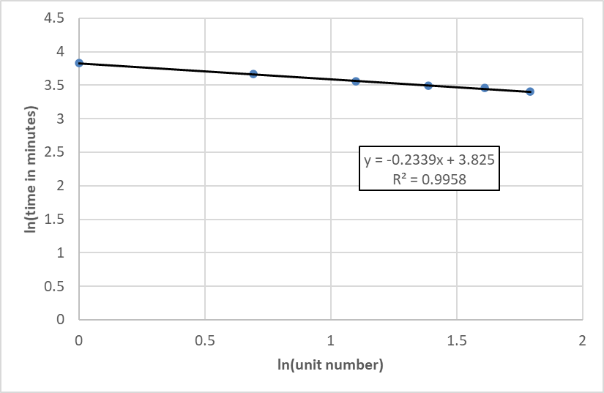
Log-Linear Regression
$$\ln{\hat{y}}=β_{0}+β_{1}\ln{x_{1}}$$

Slide 36
Logistic Regression

Slide 37

(Multiple) Logistic Regression
Used when one of our output (or predicted) variables is categorical.
Example: predicting whether a patient has a disease present or not based on age, blood pressure and smoking habits
This is pushing the limits of what Excel is designed to do. We can use the Solver add-in package in Excel to maximize the log-likelihood of a correct result, subject to a “cut-off” probability identified by the user.
$$\ln{\frac{p}{(1−p)}}=β_{0}+β_{1}x_{1}+β_{2}x_{2}+…+β_{n}x_{n}$$

Slide 38
Logistic Regression
$$\ln{\frac{p}{(1−p)}}=β_{0}+β_{1}x_{1}+β_{2}x_{2}+β_{3}x_{3}$$

Slide 39
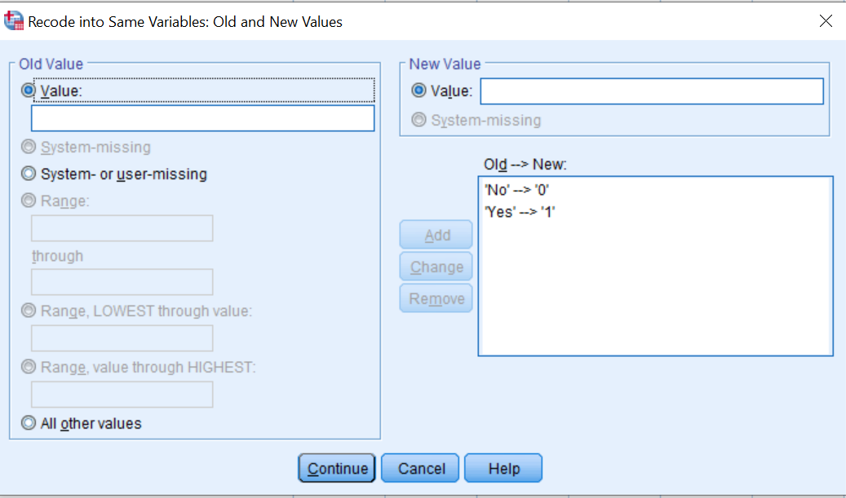
Logistic Regression
Recoding the binary yes/no predicted variable into a numerical 0/1 variable is very easy in SPSS (point-and-click interface).

Slide 40
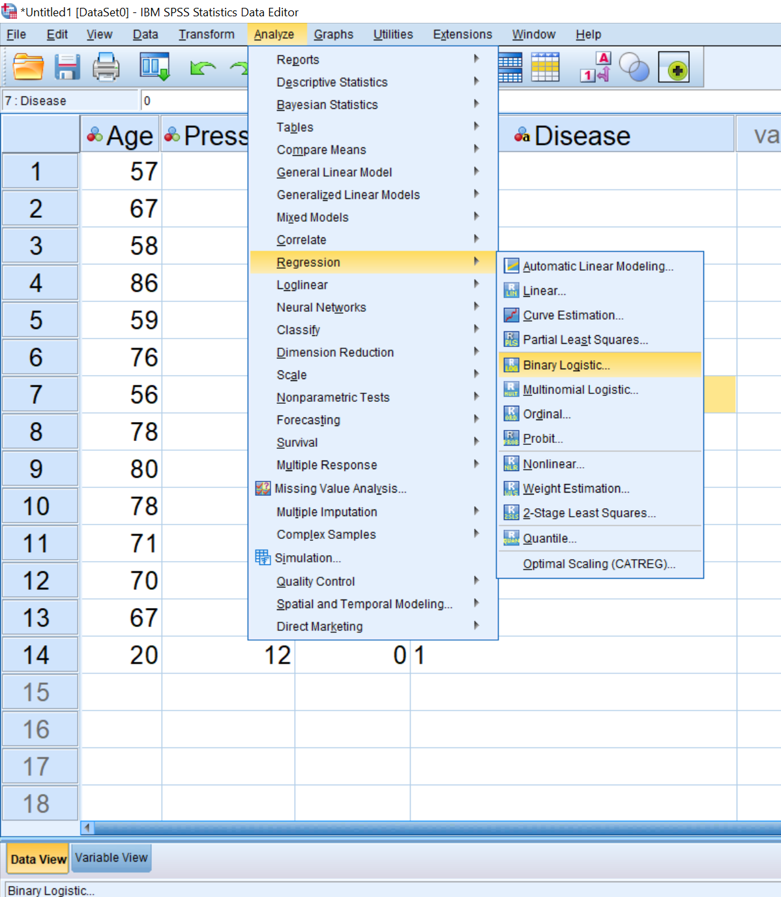
Logistic Regression
Then simply select “Binary” Logistic from the Analyze-Regression drop-down menu…

Slide 41
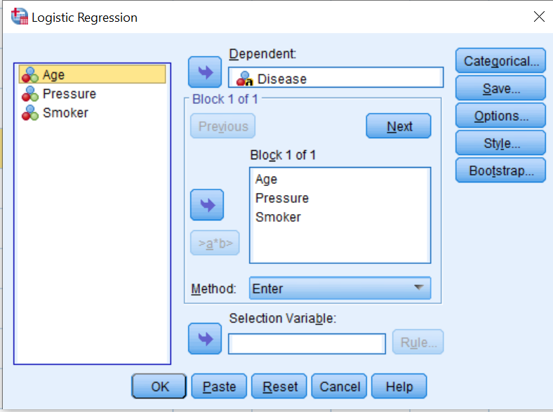
Logistic Regression
Select your dependent (predicted) and independent variables (predictors)…

Slide 42
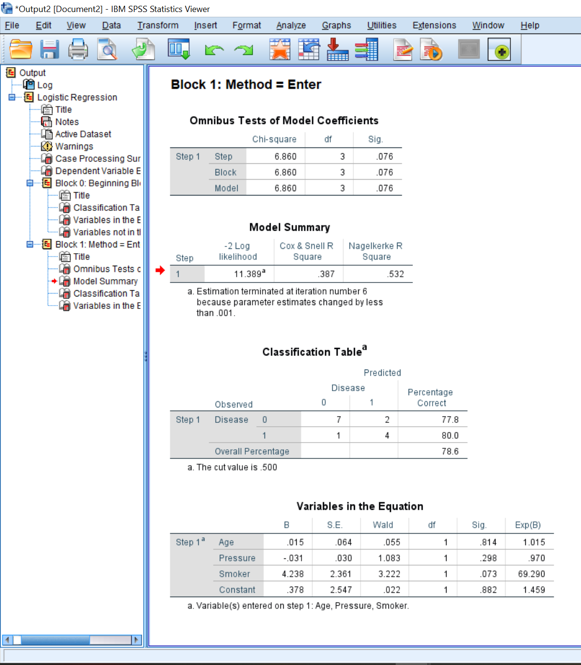
Logistic Regression
…and SPSS will build the model, report the coefficients, and tell you how well the model performs.

Slide 43
Ordered Logistic Regression

Slide 44
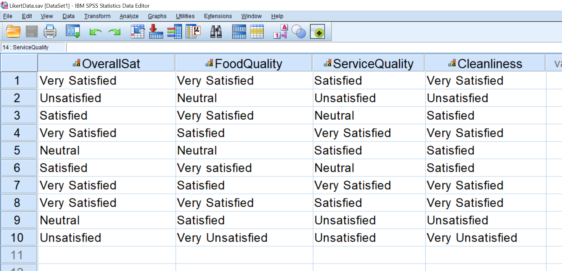
Ordered Logistic Regression
Previously we used dummy variables to cope with categorical variables and logistic regression to cope with binary dependent variables. But what if the dependent variable is ordinal? This is typical of Likert data (as an example) where there is a natural order to the data:
Very Satisfied
Satisfied
Neutral
Unsatisfied
Very Unsatisfied

Slide 45
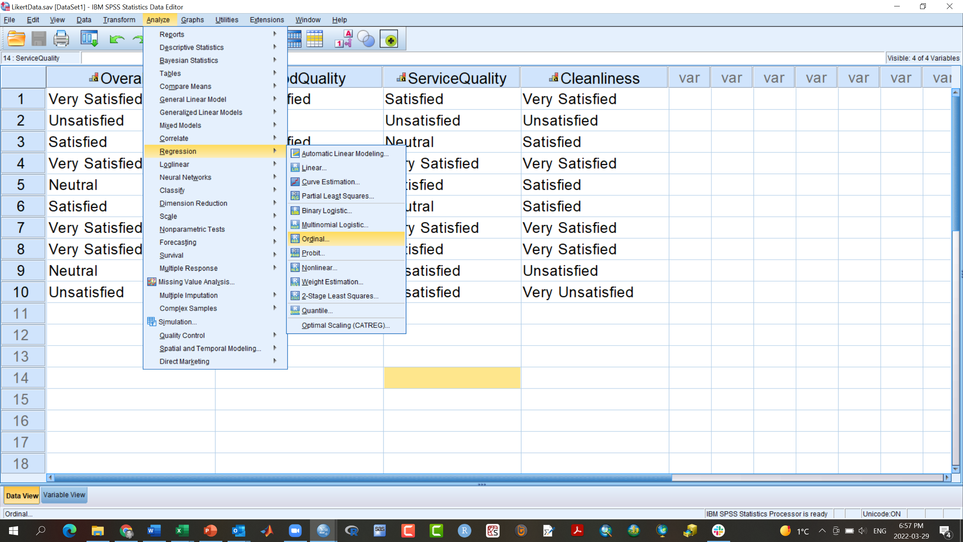
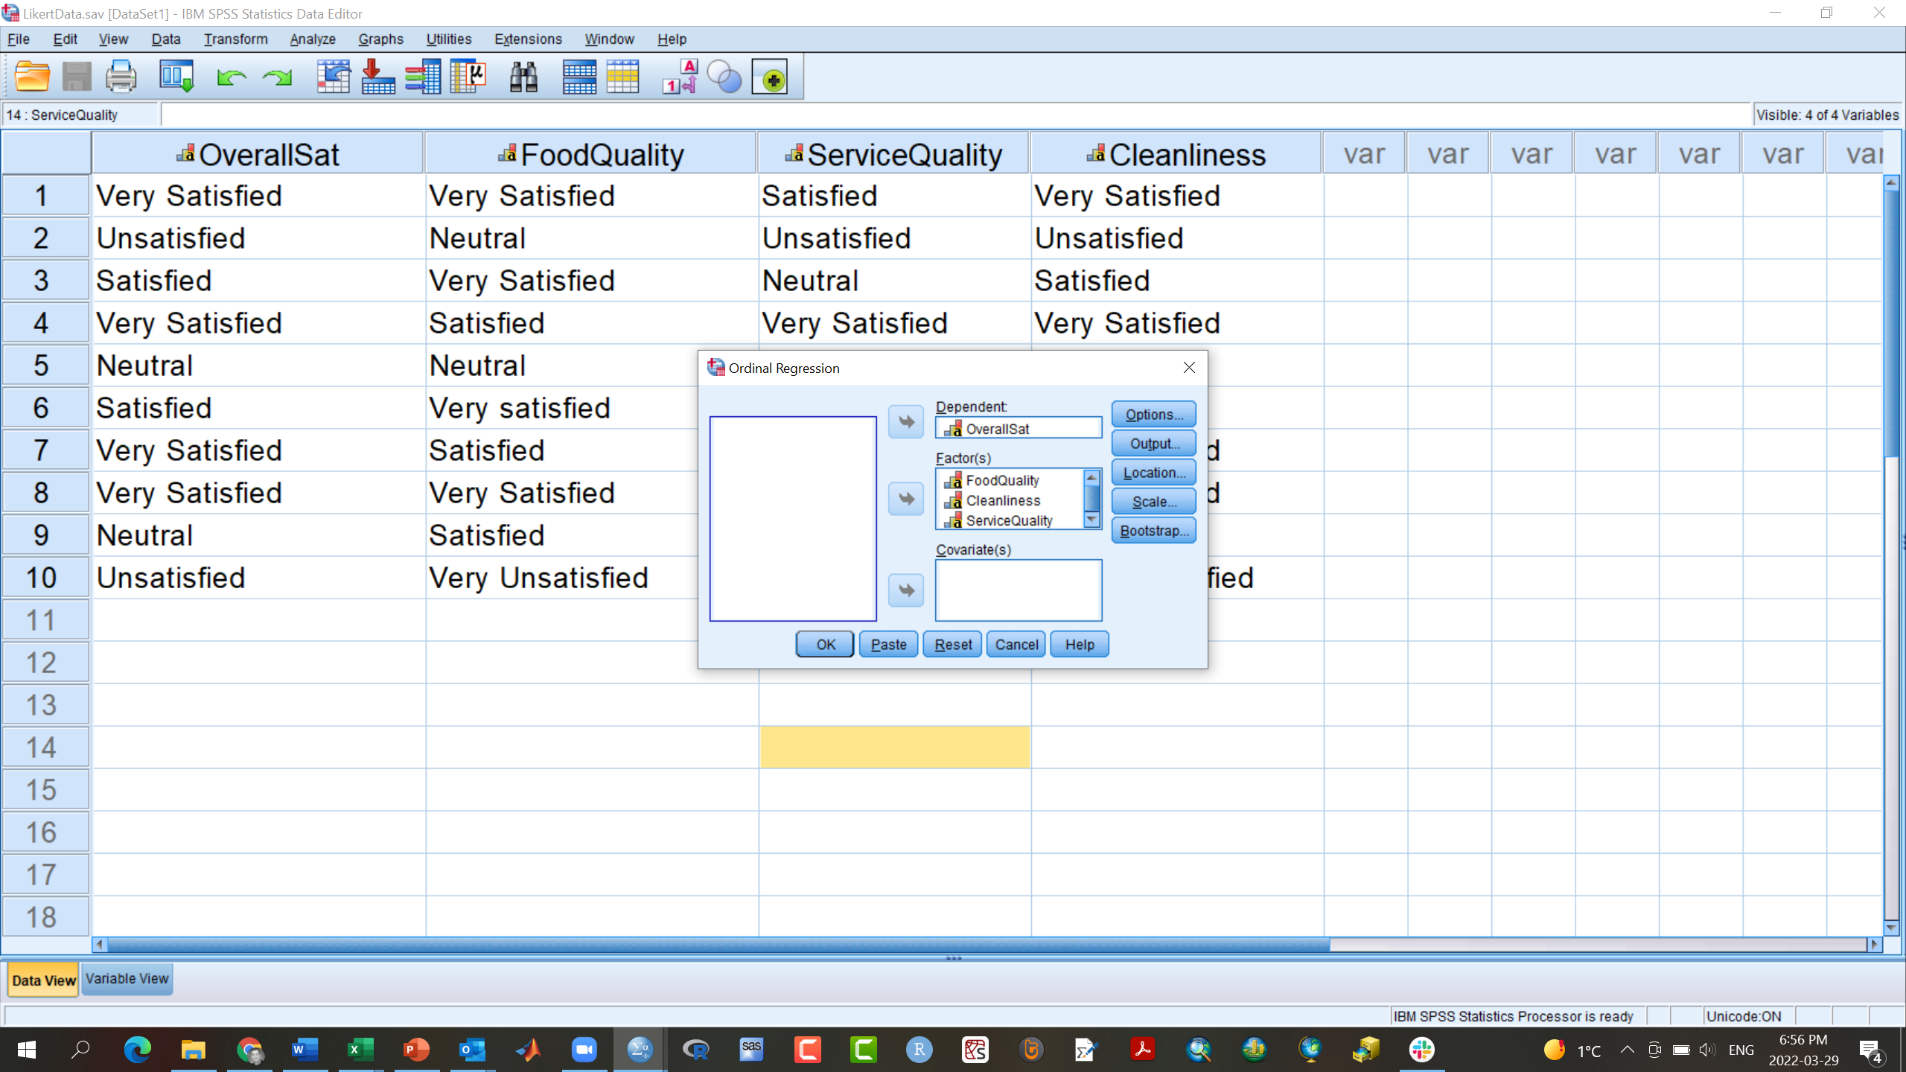
Ordered Logistic Regression
Categorical “factors”
Continuous predictor variables (if you have any) would go here

Slide 46
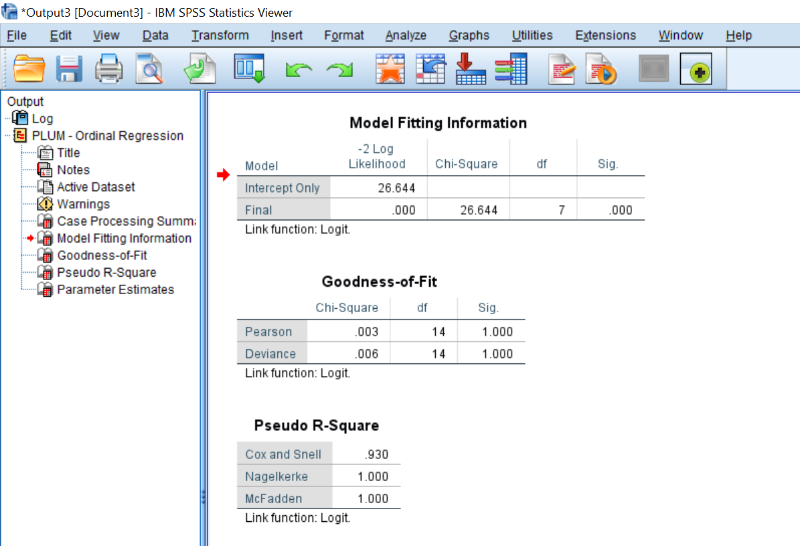
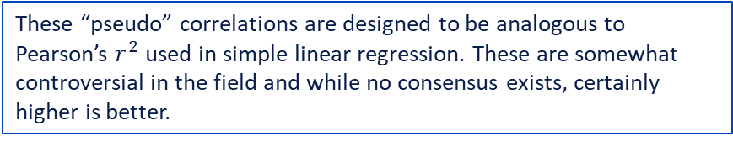
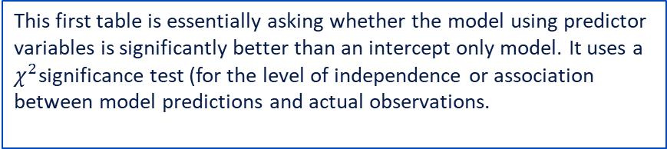
Ordered Logistic Regression
This first table is essentially asking whether the model using predictor variables is significantly better than an intercept only model. It uses a $χ^{2}$significance test (for the level of independence or association between model predictions and actual observations.
The second table is testing whether the model differs significantly from the observed data. If we find that deviation is significant, our model isn’t very good. Here we obtain perfect results suggesting that there is virtually no deviation from the model’s predicted results and those actually observed.
These “pseudo” correlations are designed to be analogous to Pearson’s $r^{2}$ used in simple linear regression. These are somewhat controversial in the field and while no consensus exists, certainly higher is better.

Slide 47
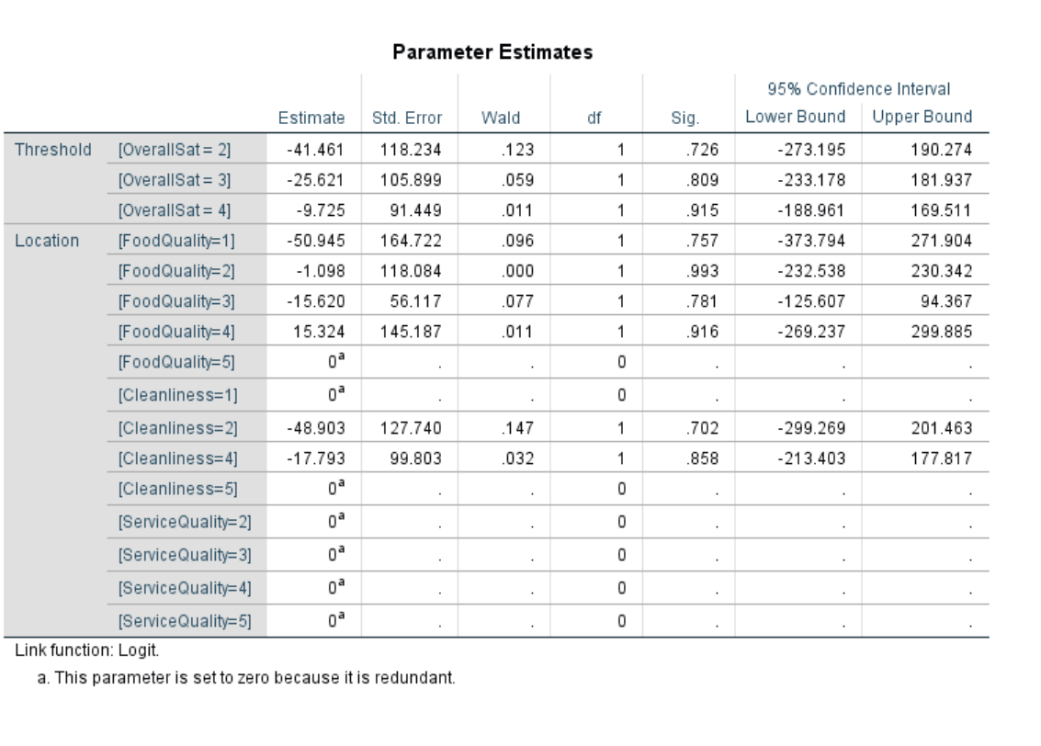
Ordered Logistic Regression
SPSS then reports the regression model. The “estimates” are the coefficients for each of the regressors. Imagine that each of the regressors are dummy variables taking on values of either 0 or 1.
These results suggest (to no surprise) that low cleanliness of the restaurant and low satisfaction with food quality lead to lower overall satisfaction.
Note that the model has entirely removed service quality. This is because SPSS found service quality to be entirely redundant with either food quality or cleanliness (i.e., it adds nothing to the ability of the model to predict overall satisfaction).

Slide 48
Factorial Logistic Regression

Slide 49
Factorial Logistic Regression
Ordered Logistic Regression is great if the dependent variable is ordered but what if it isn’t? Suppose I want to be able to predict a person’s favourite sport. In this case, possible outcomes for the dependent variable include {soccer, baseball, football, basketball, etc.}. There is no “order” to this variable. In this case, we would use Factorial Logistic Regression (sometimes called Multinomial Logistic Regression) where the dependent variable is nominal – it has no order.

Slide 50
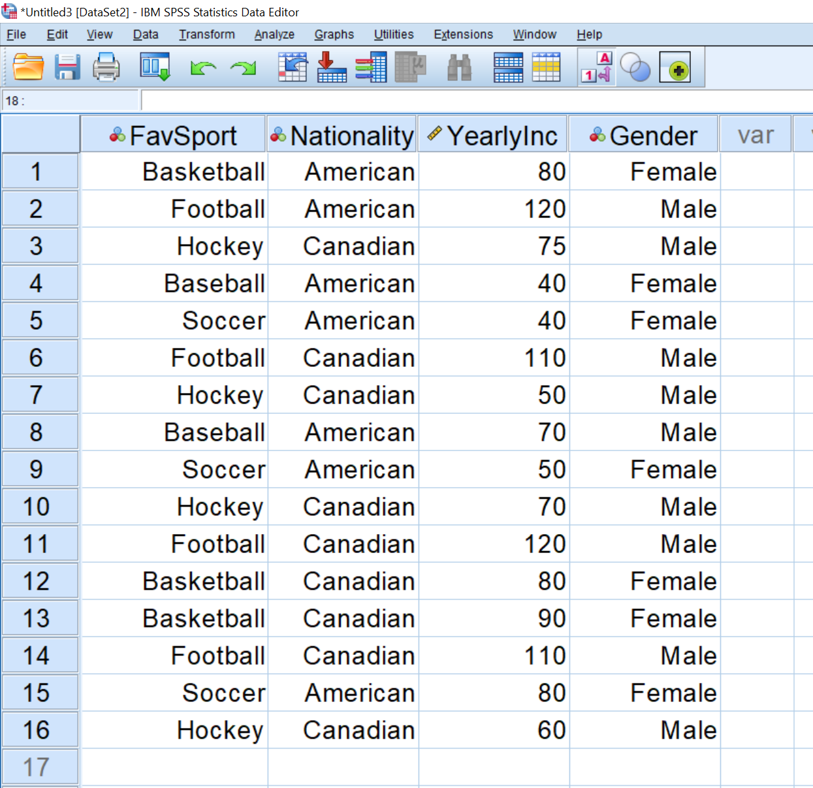
Factorial Logistic Regression
I’ve setup my data in SPSS as at right.
Favourite Sport is a dependent, nominal variable.
Nationality is an independent dichotomous nominal variable (my data includes only Americans and Canadians and so it is dichotomous in this sense)
Yearly Income is a continuous (or scale) independent variable.
Gender is a dichotomous nominal independent variable.

Slide 51
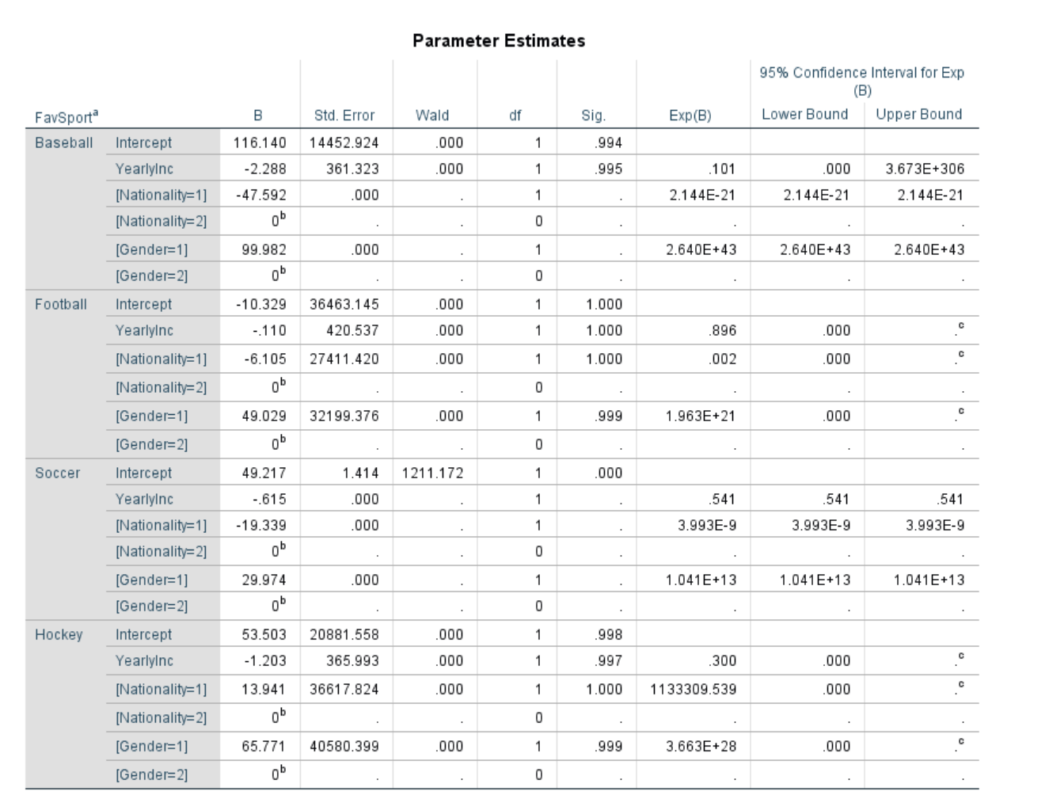
Factorial Logistic Regression
For our problem, SPSS generates what is essentially four different logistic regression models. Each reports the log-likelihood of an individual reporting their favourite sport as {Baseball, Football, Soccer, Hockey} relative to the reference category of {Basketball} as functions of gender, income, and nationality.

Slide 52
Factorial Logistic Regression
By virtue of a respondent being Canadian, the likelihood of that individual reporting being a fan of baseball (as opposed to the reference value – basketball) becomes less likely. The same is true of all other sports with the exception of hockey.

Slide 53
Factorial Logistic Regression
Why has SPSS essentially eliminated these from the model?
Because these are all dichotomous variables. There are only two possible responses included in the data. If the respondent is not Canadian, they must be American. If they didn’t report being male then they reported being female. In these categorical cases, I only need a coefficient for k-1 of the categories.

Slide 54
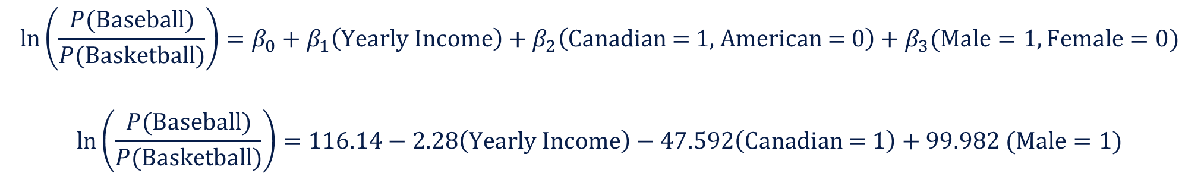
Factorial Logistic Regression
$$\ln\left(\frac{P(\text{Baseball}\text{)}}{P(\text{Basketball})}\right)=β_{0}+β_{1}\left(\text{Yearly} \text{Income}\right)+β_{2}\left(\text{Canadian}\text{ = 1, }\text{American}\text{ = 0}\right)+β_{3}(\text{Male}=1, \text{Female}=0)$$
$$\ln\left(\frac{P(\text{Baseball}\text{)}}{P(\text{Basketball})}\right)=116.14−2.28\left(\text{Yearly} \text{Income}\right)−47.592\left(\text{Canadian}\text{ = 1}\right)+99.982 (\text{Male}=1)$$

Slide 55
Multivariate Multiple Regression

Slide 56
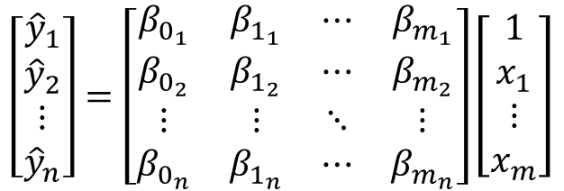
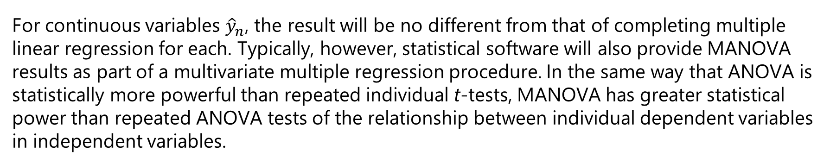
Multivariate Multiple Regression
In all the cases we’ve looked at thus far, there has been a single dependent variable. If we have more than one dependent variable, we are practicing multivariate multiple regression.
$$\left[\begin{matrix}{\hat{y}}_{1} \\ \begin{matrix}{\hat{y}}_{2} \\ ⋮ \\ {\hat{y}}_{n}\end{matrix}\end{matrix}\right]=\left[\begin{matrix}β_{0_{1}} & β_{1_{1}} & ⋯ & β_{m_{1}} \\ β_{0_{2}} & β_{1_{2}} & ⋯ & β_{m_{2}} \\ ⋮ & ⋮ & ⋱ & ⋮ \\ β_{0_{n}} & β_{1_{n}} & ⋯ & β_{m_{n}}\end{matrix}\right]\left[\begin{matrix}1 \\ x_{1} \\ ⋮ \\ x_{m}\end{matrix}\right]$$
For continuous variables ${\hat{y}}_{n}$, the result will be no different from that of completing multiple linear regression for each. Typically, however, statistical software will also provide MANOVA results as part of a multivariate multiple regression procedure. In the same way that ANOVA is statistically more powerful than repeated individual t-tests, MANOVA has greater statistical power than repeated ANOVA tests of the relationship between individual dependent variables in independent variables.

Slide 57
Useful Links
IBM SPSS is available for free to Queen’s Students
https://www.queensu.ca/its/available-tools-software
Relevant Open-Source Python Packages
NumPy; scikit-learn; statsmodels

